Slide 1

Fatal Encounters with Police
Recommendations
for a National Policy on Policing
Alexander Vizzi
Data Science Intensive Capstone Project, cohort April 2020

Slide 2
The Problem
~1000 people shot by police / year
Black and Hispanic deaths disproportionate
No national standards
Public outcry
What factors predict that a victim will be Black or Hispanic? Can policymakers target these factors to reduce disproportionate Black/Hispanic deaths?

Slide 3
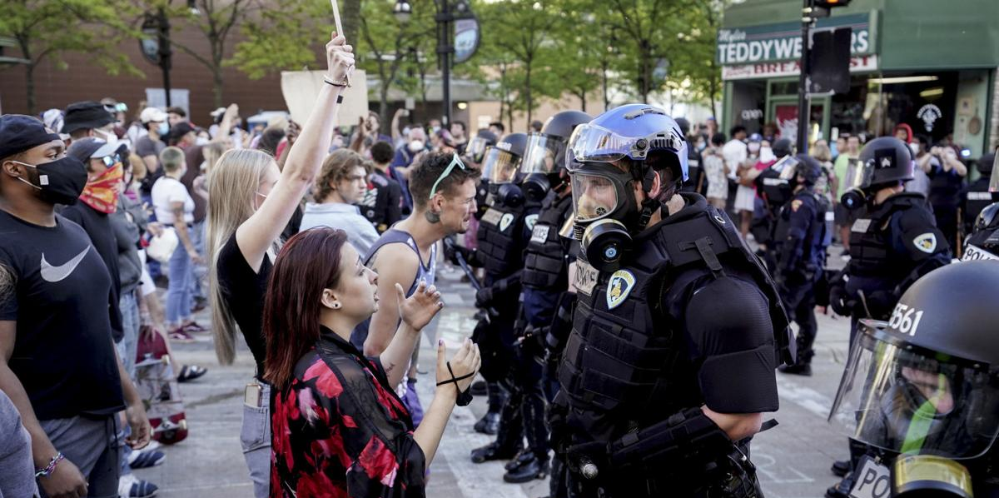
Photo by Steve Apps, Wisconsin State Journal

Slide 4

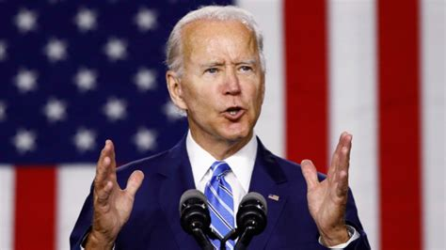
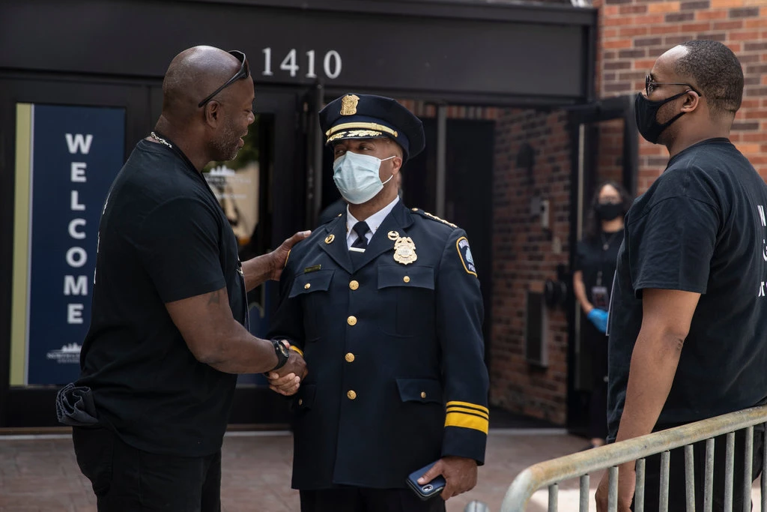
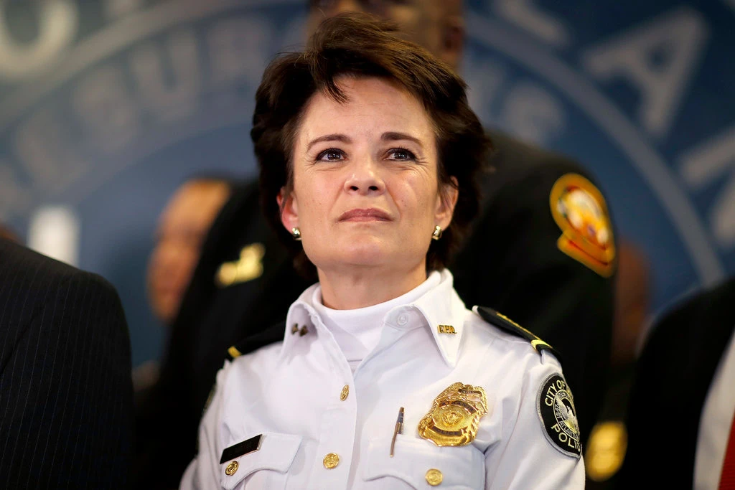

Who Wants to Know?
National Police Oversight Commission
President-elect Joe Biden
Advocacy groups
Police chiefs

Slide 5
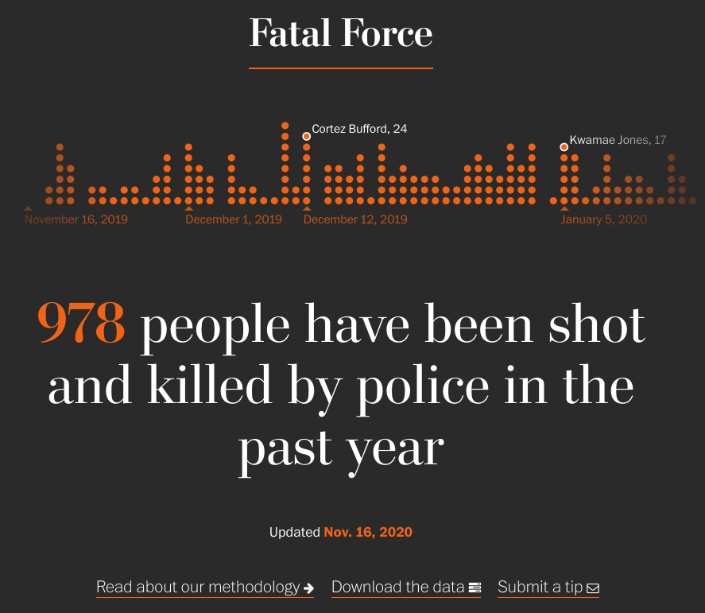
The Data
Data collection not standardized among states/cities
Hasn’t been rigorously
collected before 2014
I sourced from
Washington Post Fatal Force
Police Shootings Database

Slide 6
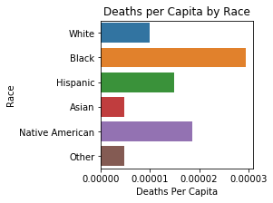
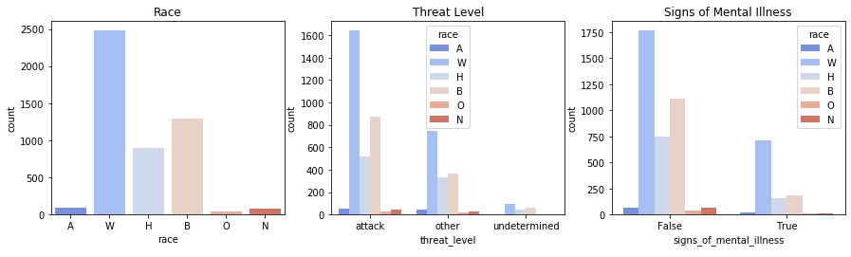
Data Exploration
Black/Hispanic deaths not proportional to population.
Proportions of races don’t seem to change when considering recorded details of the shooting.

Slide 7
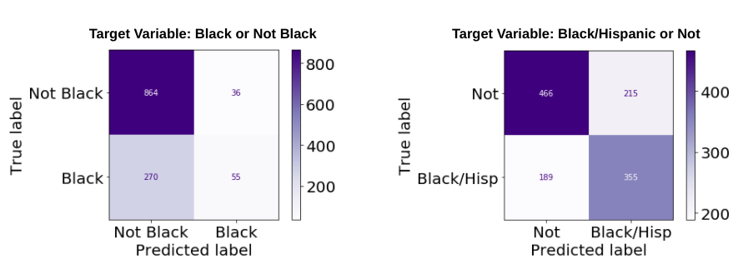
Which Target Variable to Choose?
Models were better at predicting Black & Hispanic deaths
than Black deaths alone.
vs.

Slide 8
Modeling:
Classification algorithms used
Support Vector Classifier
Logistic Regression
Gradient Boosting Classifier
Random Forest Classifier

Slide 9
Model Tuning
Different techniques worked with each model when remedying imbalanced classes:
Synthetic Minority Oversampling Technique (using imblearn)
Class_weight= ‘balanced’ argument in Scikit-Learn
Used different techniques to regularize models:
L1 and L2 regularization using ‘penalty’ argument in Scikit-Learn
Manipulating ‘C’ parameter

Slide 10
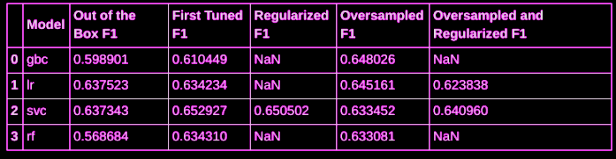
Model Observations
Performances converged for all models, with SVC edging out the others.
The difference between the best classifier’s highest performance and the worst classifier’s highest was 0.02.

Slide 11
More model observations
Despite similar performances,
tree based models emphasized certain features
while linear models emphasized others.
But some features of the tree based models were misleading and illogical.

Slide 12
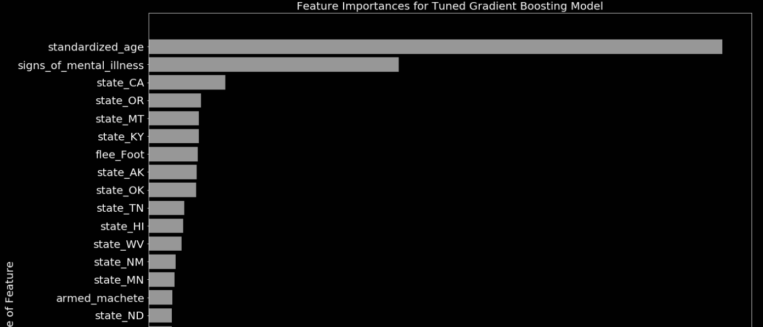
Montana and North Dakota saw no Black or Hispanic deaths at all in the dataset, but are included in the 20 most important features (out of 100 features).

Slide 13
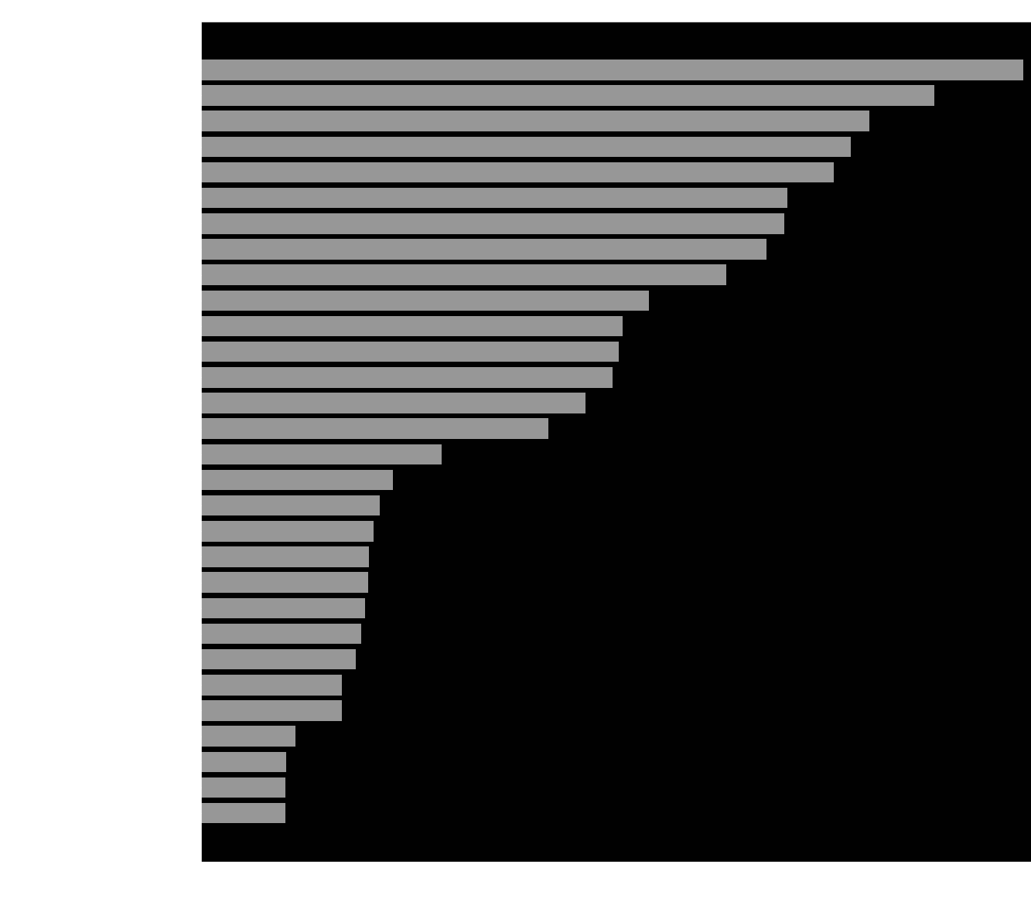
SVC’s important features made sense with the dataset.
Despite inconsistent performances,
the logistic regression models highlighted
similar features to the better performing SVC models

Slide 14
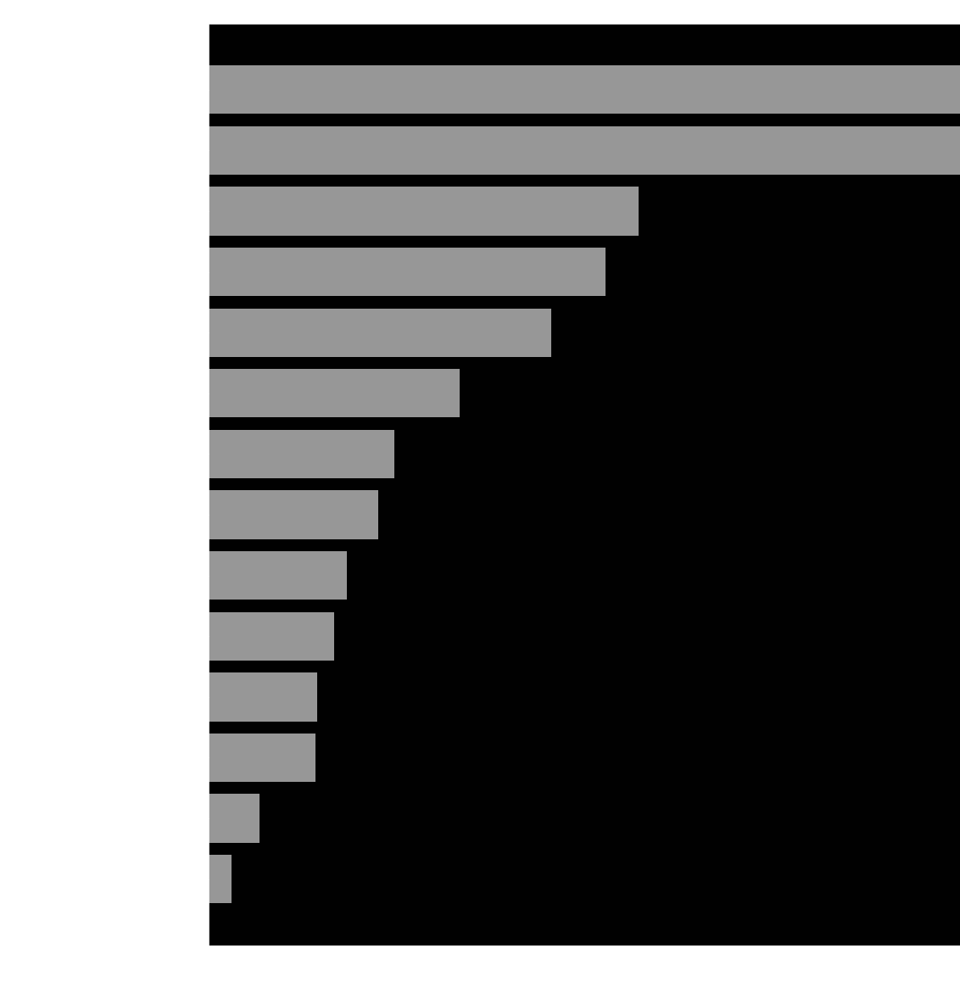
Takeaways from important feature plots:
Circumstances of shooting not as influential
State differences are key

Slide 15
Policy Recommendations
Demographics matter: diverse states appear often
Other factors matter: some less diverse states appear
Mental health training, policies that teach tactics for unarmed/fleeing civilians may not matter
Body cameras may not matter (for this goal): these predicted Black/Hispanic deaths
Should standardize data collection, include regional specifics

Slide 16
Further Research
Include demographic features
Include state-specific and county-specific features
Include differences in state restrictions on use of force, racial diversity of police force, changes to policing that have been attempted already

